Slide 1
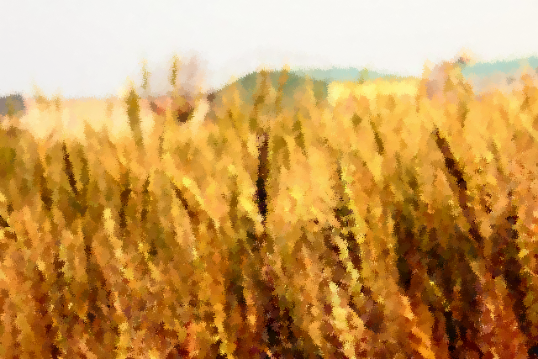

Predicting Optimal Wheat Cultivation Areas in Taiwan (Taichung)
2020/09/16 Jiaqi Yu & YCT

Slide 2

Current situation of wheat in Taiwan
Temperate grass crop, with the most cultivated variety in Taiwan being Taichung Selection 2 (less sensitive to high temperatures and long daylight hours).
Main cultivation areas are Da-Ya in Taichung and Xuejia in Tainan, with a cultivation area of only about 120 hectares.
Climate impact → Wheat consumption in Taiwan is high, but the cultivation area is limited, relying heavily on imports.
（Source: 陳筱鈞,2013 ）
Notes:
既然小麥在台灣食用量很高，如果是氣候影響小麥在台灣的種植量很少，那到底台灣哪些地方適合種？？

Slide 3

Design thinking
Database development
Spatial + temporal data collection and collation
Optimal growth parameters for wheat
Optimal growing temperature, humidity, light, soil quality
create a suitability zone map
Build models, import data, build maps

Slide 4

Data Collection
Climate data :
Choice of timing
→ January-April climate data for the 2016-2018 years
Sowing
Germination
Seedling stage with three leaves
Jointing and booting stage
Heading and flowering stage
Grain filling stage
Harvest
Cultivation time: autumn and winter, （November to March） Optimal sowing time: Sowing in November, avoiding high temperature, typhoon, plum rain
（Source: 陳筱鈞,2013）

Slide 5
Data Collection
Soil data -> soil distribution map in Taiwan including latitude, longitude and altitude Correlation of environmental factors Physiological parameters of wheat growth

Slide 6
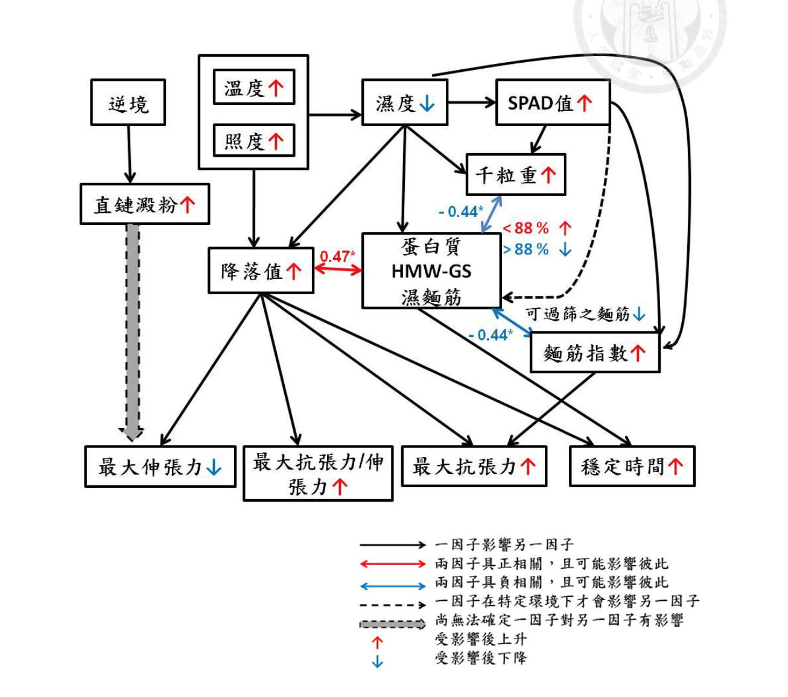
Correlation between environmental factors and wheat quality
the most relevant environmental factors that affect wheat quality :
humidity temperature light
（Source: 陳筱鈞,2013）

Slide 7
Wheat physiological parameters (literature study)
The optimal temperature for the filling period is 21.3±1.27 °C
The optimal humidity during full period 86%-88%
The optimal light for the fullness period is 9 MJ/m2
The most suitable soil is well drained (not flood-tolerant), but the topsoil is the deeper loam soil is the most suitable, and the PH value is 6~7
Temperature (high temperature)
Humidity (low humidity)
Light intensity (high sunlight)
Key environmental factors affecting wheat varieties
（Source: 陳筱鈞,2013 & Farooq 2011）

Slide 8



Data standardization
1. Filter Taichung weather stations:
- use Google Map filters agricultural areas-> 4 areas -> 23 areas 2. Use R to clean climate data:
hour -> day -> mean In units of weeks, take the median Handling of null values -> Fill with mean Calculate temperature and humidity ranking based on wheat physiological data Sum the temperature and humidity rankings
temperature
humidity
light
soil

Slide 9
 | Temperature ( 6 levels) | Temperature ranking | Humidity (in 4 levels) | Humidity ranking
optimum | 21.0-22.0 | 6 | 86%-88% | 6
2nd growable | 20.0-20.9, 22.0-22.9 | 5 | >70%, <86% | 4
3rd growable | 18.0-19.9，23.0-24.9 | 4 | >70%, <86% | 4
4th reduce growth | 25.0-26.9, 16.0-17.9 | 3 | 60%-70% | 2
5th reduce growth | 27.0-29.9, 13.0-15.9 | 2 | 60%-70% | 2
6th limited growth | 30.0-31.9, 10.0-11.9 | 1 | >88%, <60% | 0
7th limited growth | >32, <10 | 0 | >88%, <60% | 0
Optimal soil quality: good irrigation and drainage (not resistant to flooding), but the deep topsoil is the most suitable, and the PH value is 6~7

Slide 10
Arc GIS Pro Kriging

Slide 11

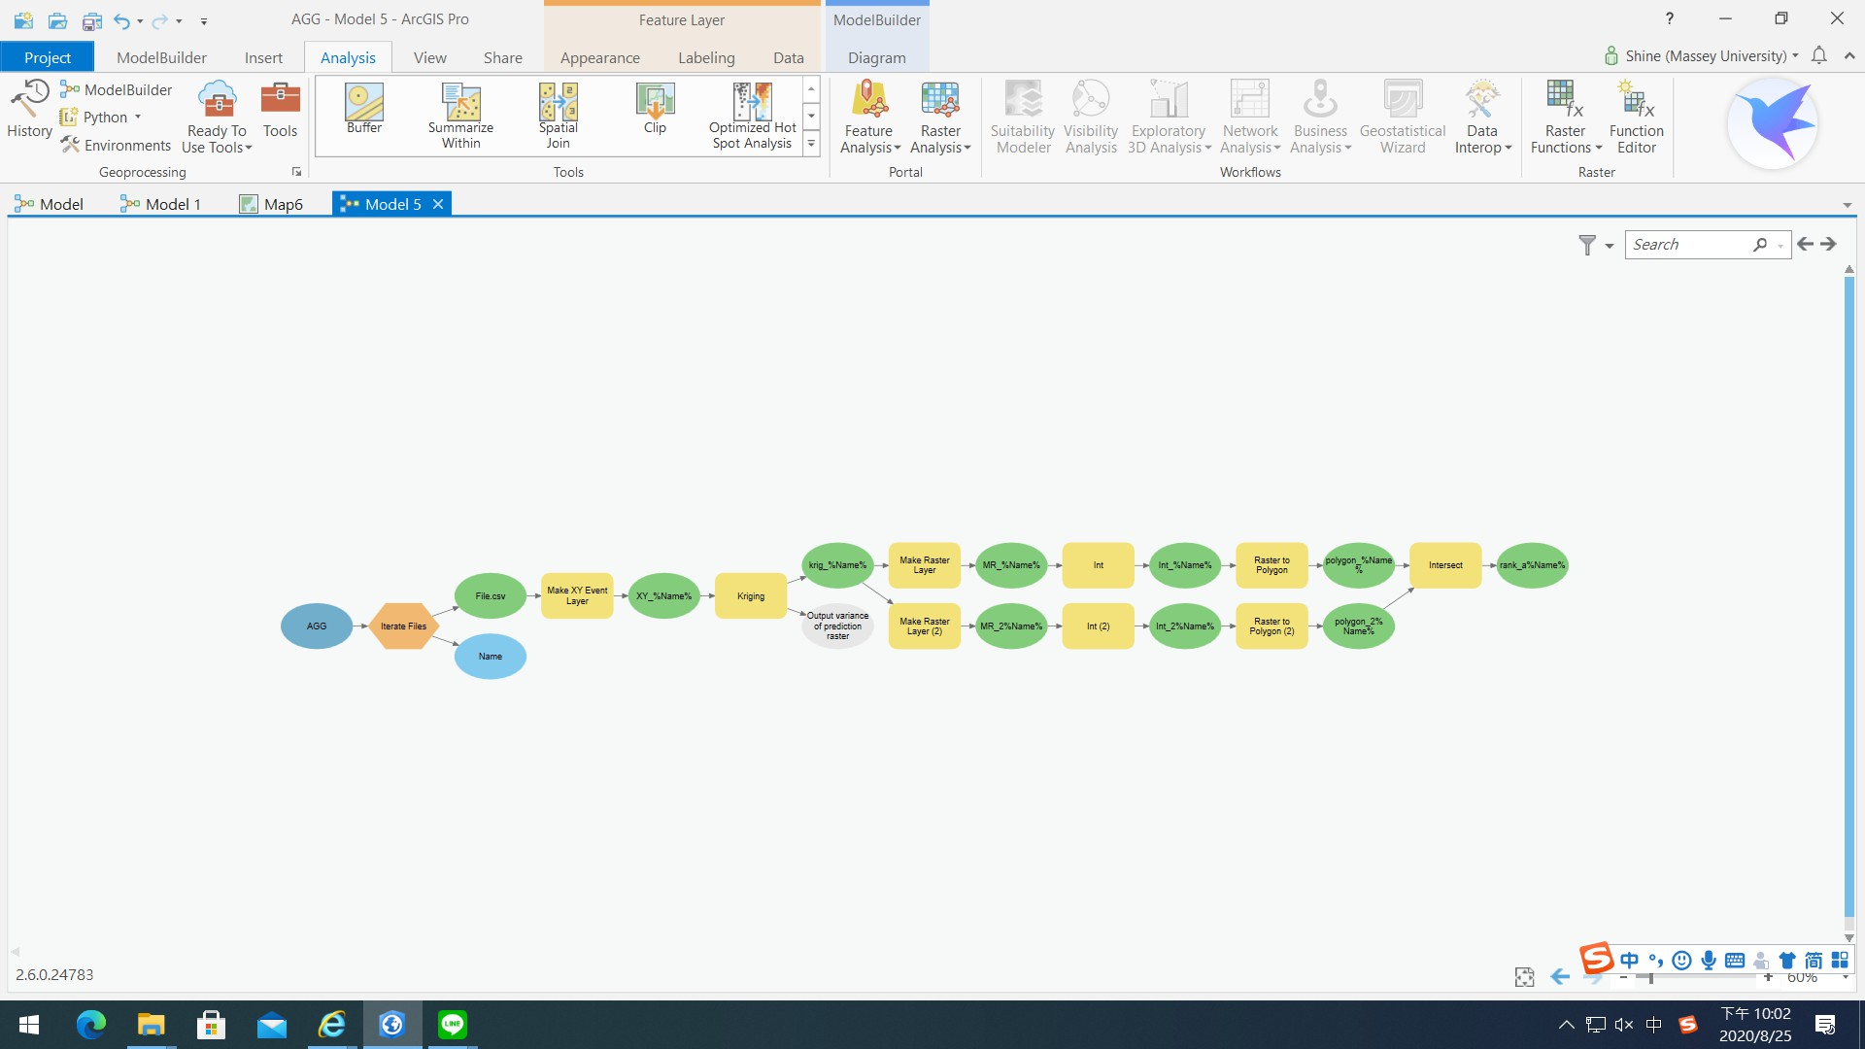
1. Use the data of Arc GIS pro Kriging run 4 weather stations in Taichung
Build the sevariogram model

Slide 12
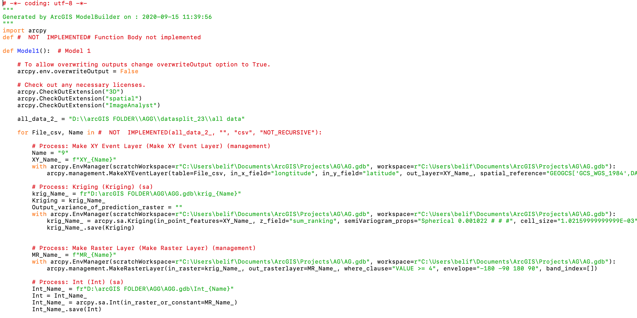
Arc GIS Pro exported Python code

Slide 13
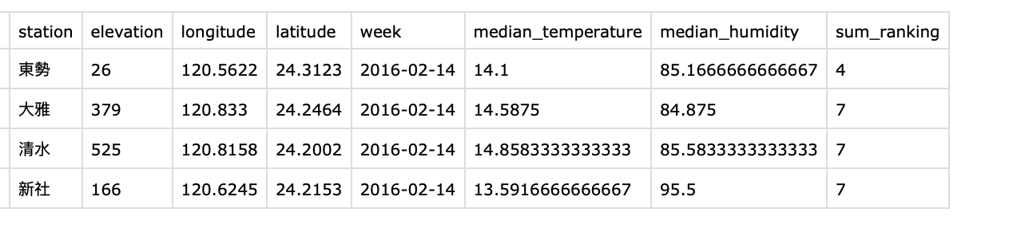
Import the file → iterate files
Notes:
eg. 6.csv (表示2016年2月第三週)

Slide 14
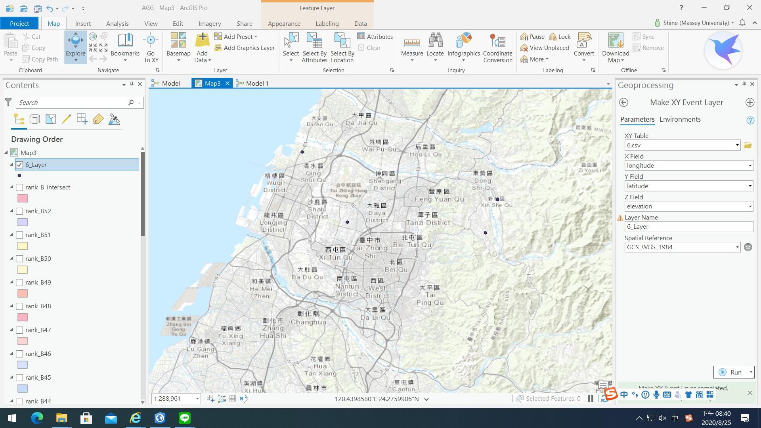
Make XY event layer → Creates the location of the observation on the map

Slide 15
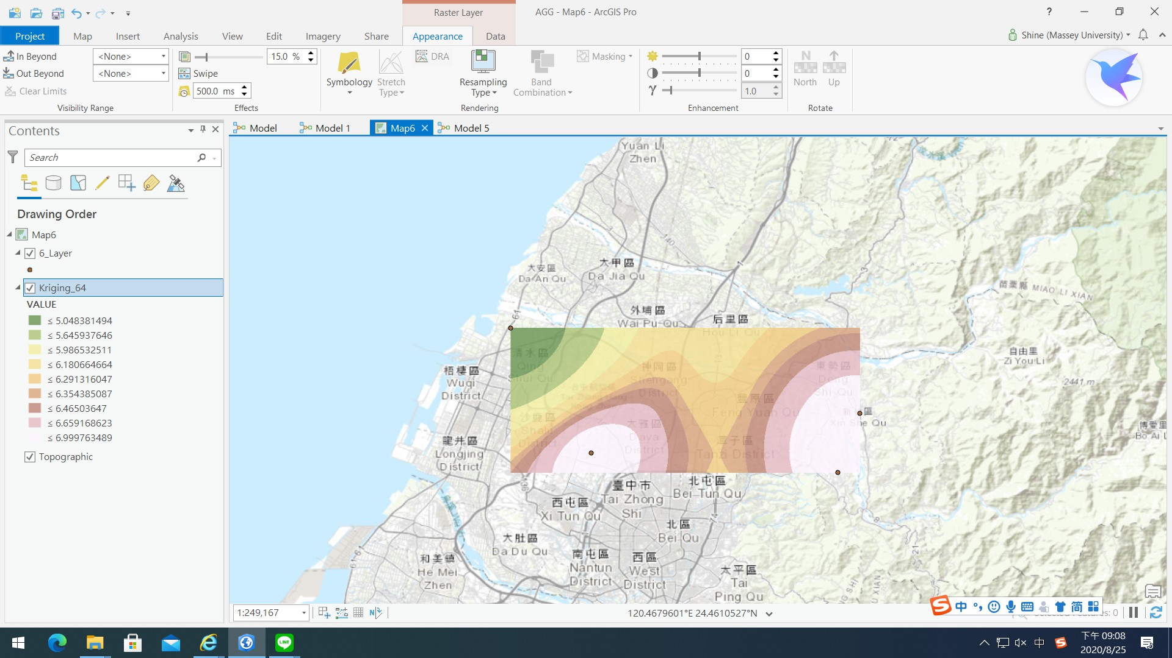
Kriging dots-> areas
氣象站間距離
氣象站的sum-ranking 值

Slide 16
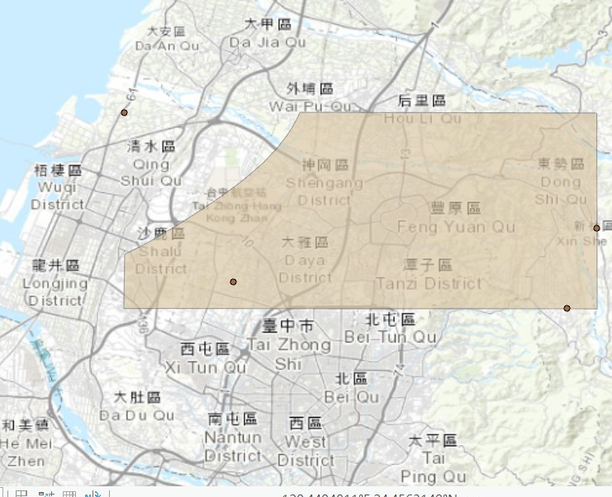
Make raster layers to create filters
Areas suitable for cultivation Suitable planting timing
Filter:
sum_ranking in the area of [6, 8).
In this case: During mid-February 2016 Eligible regions with a score of [6,8) out of 12

Slide 17
 | Temperature (in 6 levels) | Temperature ranking | Humidity (in 4 levels) | Humidity ranking
optimum | 21.0-22.0 | 6 | 86%-88% | 6
2nd growable | 20.0-20.9, 22.0-22.9 | 5 | >70%, <86% | 4
3rd growable | 18.0-19.9，23.0-24.9 | 4 | >70%, <86% | 4
4th reduce growth | 25.0-26.9, 16.0-17.9 | 3 | 60%-70% | 2
5th reduce growth | 27.0-29.9, 13.0-15.9 | 2 | 60%-70% | 2
6th limited growth | 30.0-31.9, 10.0-11.9 | 1 | >88%, <60% | 0
7th limited growth | >32, <10 | 0 | >88%, <60% | 0
grade Level A Level B
Optimal soil quality: good irrigation and drainage (not resistant to flooding), but the deep topsoil is the most suitable, and the PH value is 6~7

Slide 18
The composition of Level A & Level B
Level A (rank 8-12) | Temperature (°C) | Relative humidity (%)
 | 27.0-29.9, 13.0-15.9 | 86%-88%
 | 18.0-19.9，23.0-24.9 | >70%, <86%
 | 21.0-22.0 | 60%-70%
 | 25.0-26.9, 16.0-17.9 | 86%-88%
 | 18.0-19.9，23.0-24.9 | 86%-88%
 | 21.0-22.0 | >70%, <86%
 | 20.0-20.9, 22.0-22.9 | 86%-88%
 | 21.0-22.0 | 86%-88%
Level B (rank 6-7) | Temperature (°C) | Relative humidity (%)
 | 21.0-22.0 | >88%, <60%
 | 18.0-19.9，23.0-24.9 | 60%-70%
 | 27.0-29.9, 13.0-15.9 | >70%, <86%
 | >32, <10 0 | 86%-88%
 | 20.0-20.9, 22.0-22.9 | 60%-70%
 | 25.0-26.9, 16.0-17.9 | >70%, <86%
 | 30.0-31.9, 10.0-11.9 | 86%-88%

Slide 19
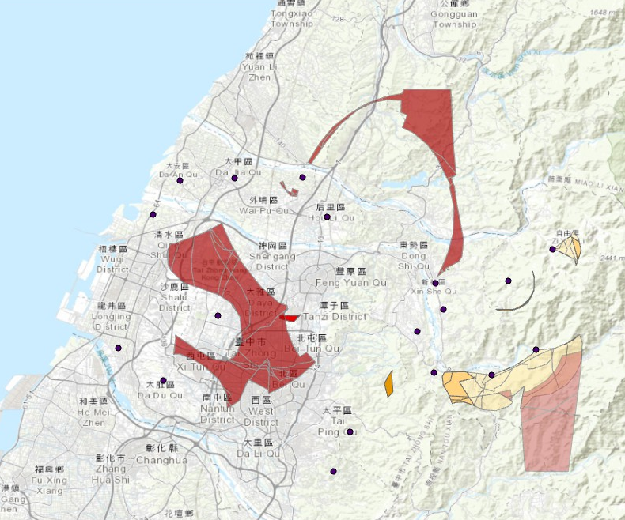
導入台中19個氣象站資料
Arc GIS Pro imports data from 23 weather stations
Early January to end March 2017
Early February to end April 2017
Mid-February to mid-April 2018
Early January to end February 2016
Early January to end April 2017
Mid-February to mid-April 2018
Level A (rank 8-12)
Level B
(rank 6-7)

Slide 20
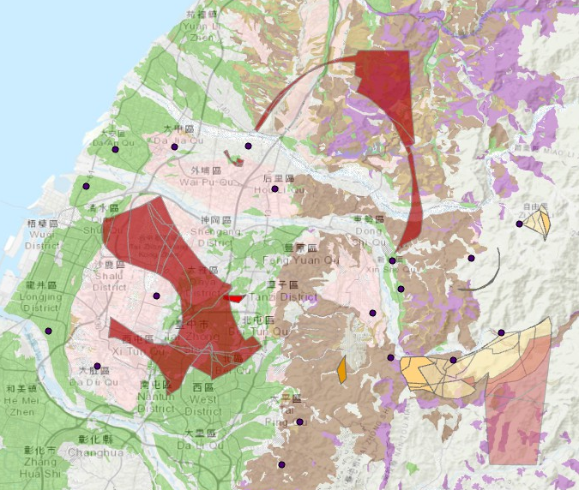

導入台中19個氣象站資料
Daya District Taichung Beitun District North Nantun District Xitun District
結果
Early January to end March 2017
Early February to end April 2017
Mid-February to mid-April 2018
Early January to end February 2016
Early January to end April 2017
Mid-February to mid-April 2018
Level A (rank 8-12)
Level B (rank 6-7)
土壤分類
Alluvium soil
Red soil
Collapsed soil
Stony soil
Notes:
沖積土：台灣平原區主要土壤，適合農耕。紅壤：雖然排水性不錯，但有極強酸性。崩積土：石塊墜落，堆積而成。石質土：含較多碎石，土壤的半成品。

Slide 21

conclusion
Suitable sowing time The fullness period for Level A and Level B falls from early January to mid-February. Therefore, the recommended sowing time is from early November to mid-December (consistent with the time mentioned in Chen Xiaojun's 2013 article) Suitable planting areas (can be refined to li, township, or even road) Daya District, Taichung City, Beitun District, North District, Nantun District, Xitun District, Heping District

Slide 22
，
Thank you for your attention !
Question ?

